Slide 1
Photon and Neutron (PaN) Community Beyond ExPaNDS and PaNOSC
Presenter: Teodor Ivănoaica (ELI ERIC)
Contributors: Andy Götz (ESRF), Patrick Fuhrmann (DESY)
Marta Gutierrez (EGI), Giuseppe Larocca (EGI)
Mousumi Upadhyay Kahaly (ELI ALPS), Julianne Marauska (DESY)
22th of September 2022

Slide 2
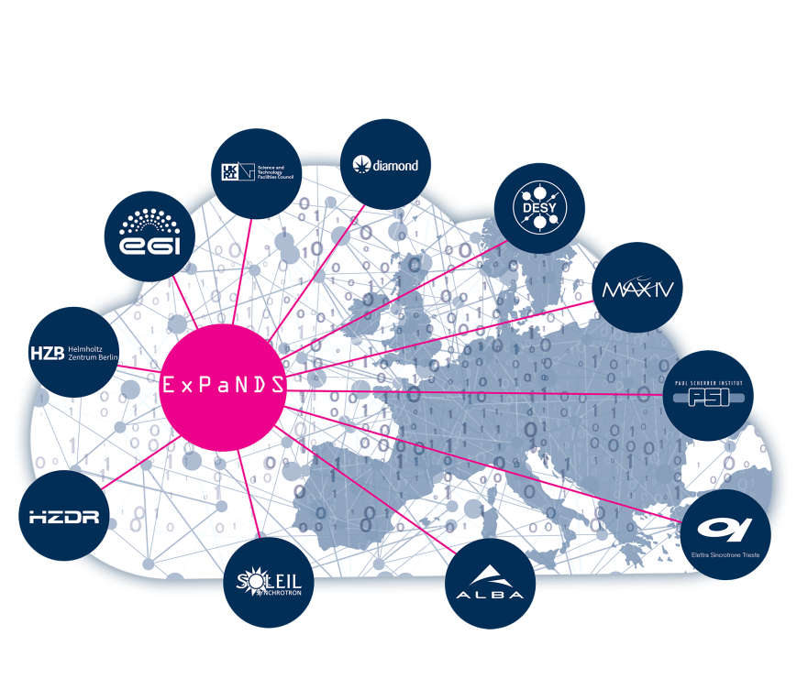

Common goal: FAIR PaN Data and Services
PaNOSC - six strategic European research infrastructures (ESRF, CERIC-ERIC, ELI Delivery Consortium, the European Spallation Source, European XFEL and the Institut Laue-Langevin – ILL, and the e-infrastructures EGI and GEANT
ExPaNDS project is a collaboration between 10 national Photon and Neutron Research Infrastructures (PaN RIs) as well as EGI.
Develop Data Commons for Neutron and Photon science

Slide 3
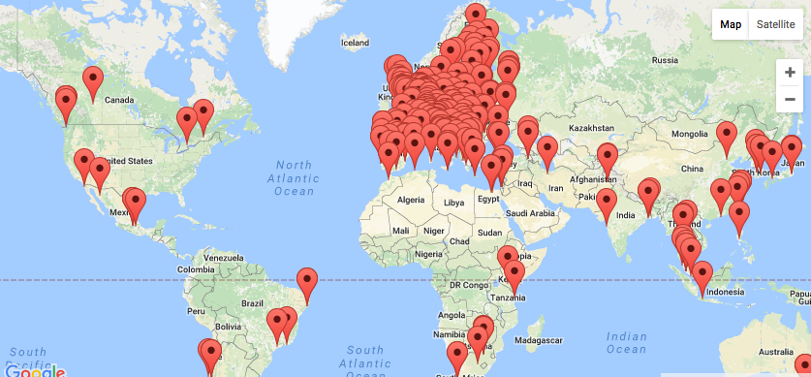
EGI: The largest distributed compute e-Infrastructure in the world
Supporting the PaN community:
to scale up resources beyond facilities.
to integrate PaN services in EOSC.
a partner and stakeholder supporting inter-disciplinary research for (not only)PaN.
27 Cloud providers
200 compute centres
>78,000 users
>1.2 M CPU
cores
>1.3 EB research data

Slide 4

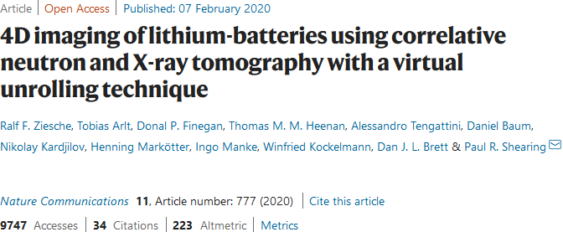

Our most important goal is to make FAIR Data available
One of the main objectives of PaNOSC and ExPaNDS is to avoid this:

Slide 5




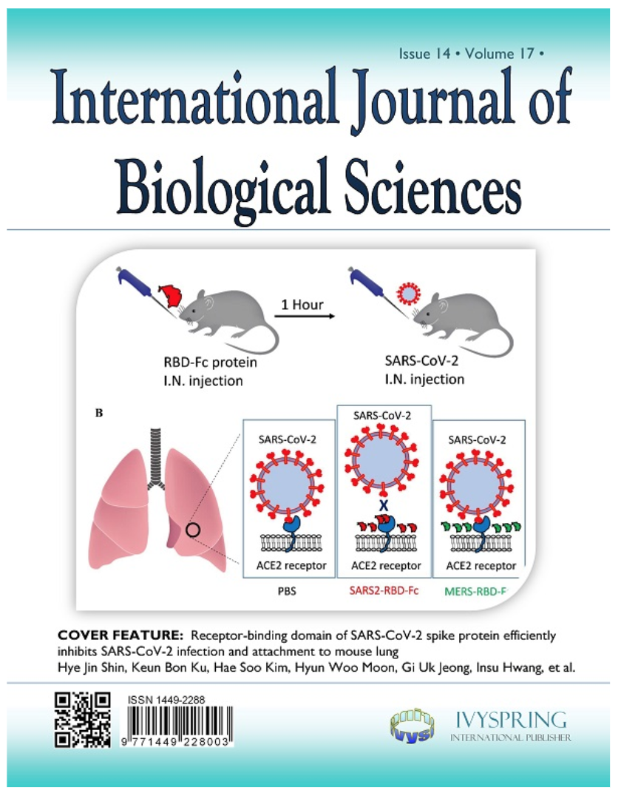
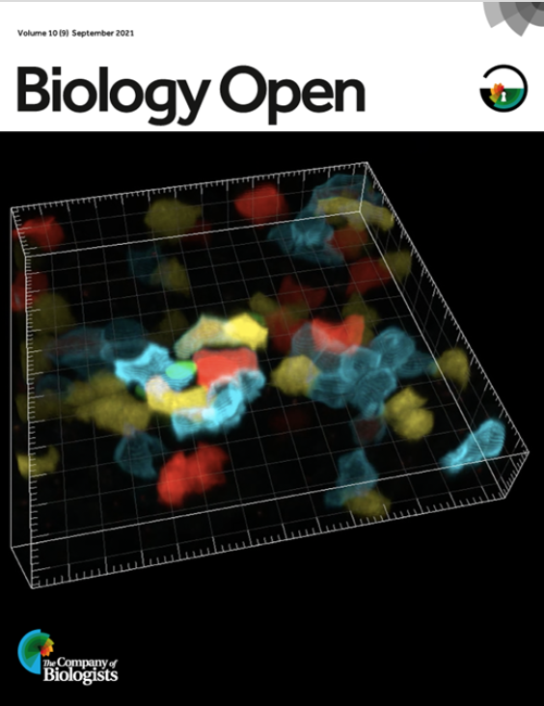



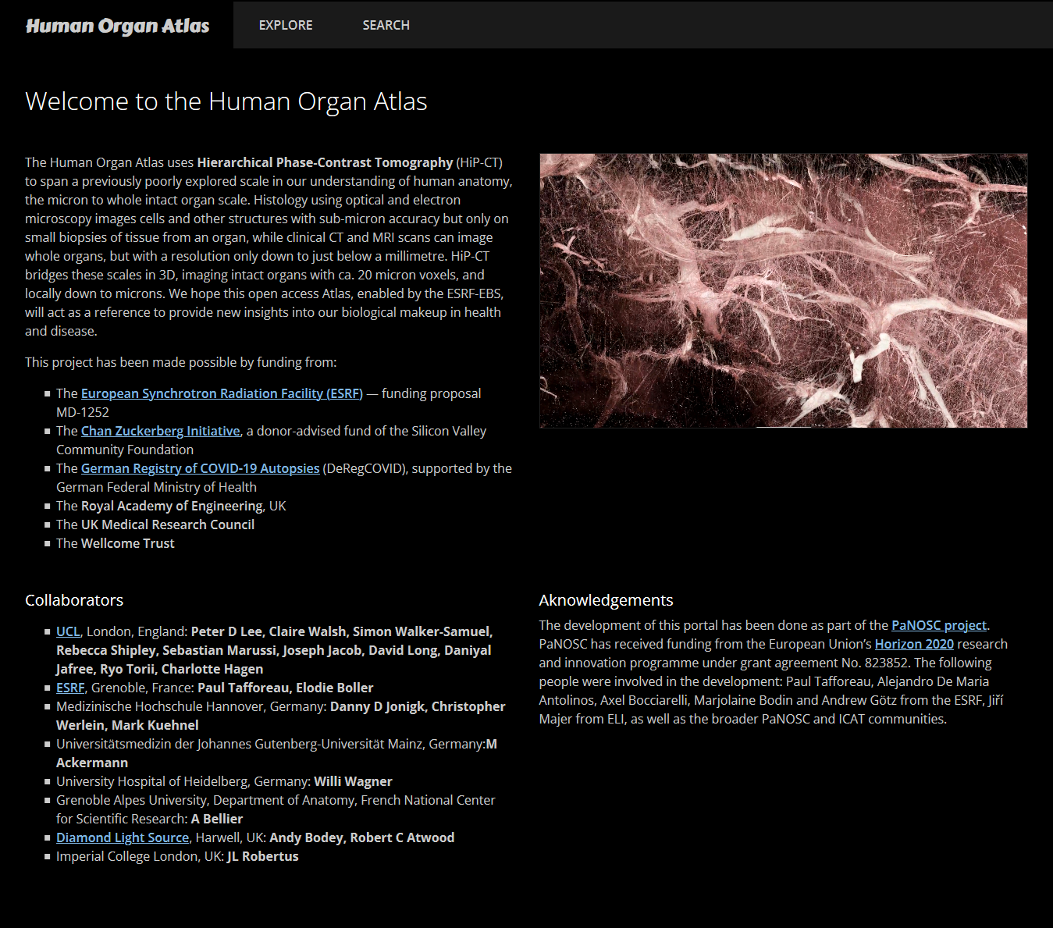






Federated PaN Search
Publisher
Open Science
Citizen Science
Human Organ Atlas
Open Data
Portal
Open Data
Portal
Open Data
Portal
PaN Open Data Commons (EOSC)
PaN Search API

Slide 6
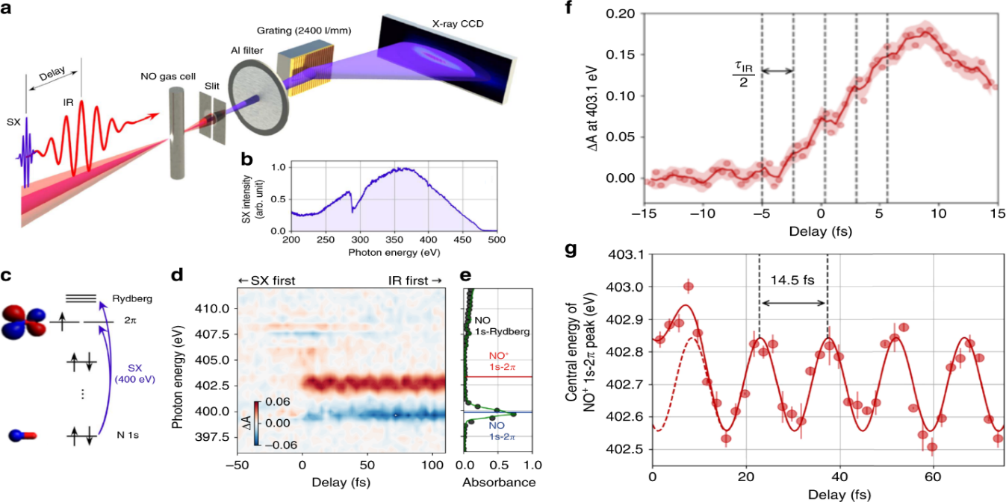

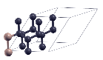
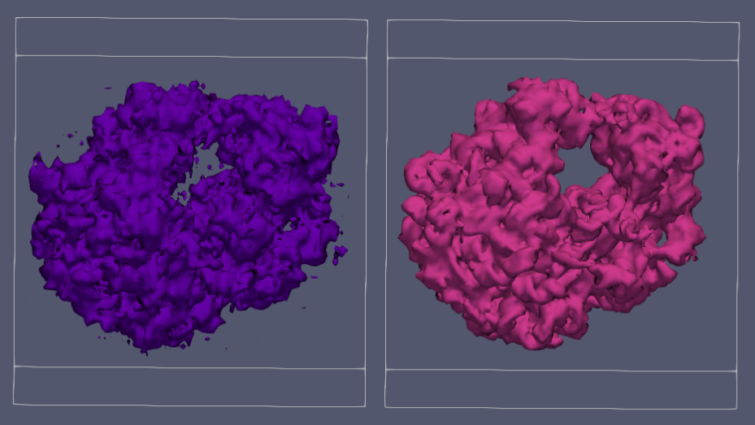
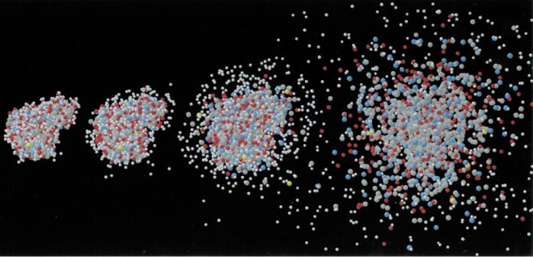

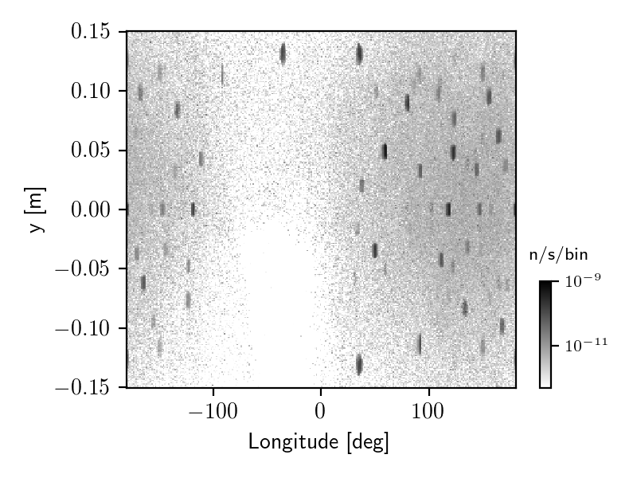



Connecting micro and macro
In-silico Neutron Diffraction: precise tool for exact structural analysis and defect detection (PaNOSC use case no. 18)
Sample
Material structure:
From experimental data
From ab-inito calculations (DFT)
Material properties, parameters:
Structure factor (from literature. or from ab-inito charge density)
Electron density, potential
...
Material database
Initial crystal structure
Ab-inito relaxation
Interaction
Signal detection and processing
Ab-inito scf
Material database
TDDFT
Particle-In-Cell
Radiation hydrodynamics
Detector properties, noise...
Unified data format following FAIR norms
Source
Propagation
Macro-observable: Simulation of neutron-scattering experiment
Micro-structure:
Bands, DOS
Potentials
Optical properties
Photon:
Raytracing
Wavefront (simulated / exp.)
Neutron:
Raytracing
Raytracing
BPM:
FFT
Finite Difference
Finite Time
FAIR
Database of experiments
Experimental characterization of sample at actual instrument
Simulation of light-matter interaction
Instrument database
e-infrastructure
Experimental light-matter interaction
Images:
Neutze, R. et. al., Nature 406, 752–757 (2000).
Ekeberg, T. et al. Physical review letters 114, 098102 (2015).
Yoon, C. H. et al. Scientific Reports 6, 24791 (2016).
Fortmann-Grote, C. et al. IUCrJ 4, 560–568 (2017).
Li, J., Lu, J., Chew, A. et al., Nat Commun 11, 2748 (2020).
https://www.panosc.eu/all-use-cases/

Slide 7


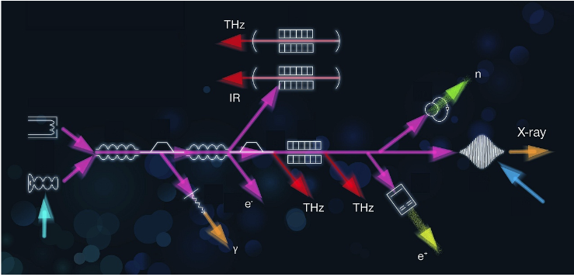



ExPaNDS use case: THZ spectroscopy analysis workflow walkthrough
1
PaN training
THZ analysis workflow query
2
EOSC marketplace
e-infrastructure
Analysis workflow service
Analysis workflow service query
Jupyter Notebook
Analysis workflow service GitLab information
Notebook service query
3
EOSC marketplace
HZDR
Data transfer service
e-infrastructure
HZDR repository
PaN Data catalogue query
Data transfer service
Data catalogue location at HZDR
Data set ID
Data set
Data transfer query
Notes:
Researcher finds a THZ analysis workflow in the training platform which informs how to reproduce the workflow
From EOSC, it find EGI Notebooks service and THZ Jupyter Notebook , which is then loaded into the notebook.
A reference dataset can be found in the EOSC “research products catalogue” which points to HZDR , from HZDR the dataset can be made available to the EGI Notebooks via Data transfer service such us FTS
For the scientific part : (this workflows can be used to validate analysis pipelines from experimental phases in the study of superconductor materials (cuprates ) . THz spectroscopy )
Nonlinear THz Spectroscopy has developed into a prosperous field of basic research in physics, chemistry and material sciences.
In high energy physics, the Higgs field couples to gauge bosons and fermions and gives mass to their elementary excitations.
Experimentally, such couplings can be verified from the decay product of the Higgs boson, the scalar (amplitude) excitation of the
Higgs field. We investigate the Higgs mode of several cuprate thin films using phase-resolved terahertz third harmonic generation (THG)

Slide 8
10 Primary Outcomes of PaNOSC and ExPaNDS
FAIR data policy and DMPs
FAIR assessment and common PID framework
Standardised metadata (Nexus/HDF5, PaN ontologies)
Federated search API for PaN data catalogues
Open Data portal for searching + downloading data
Community AAI UmbrellaId
JupyterLab notebooks and Nexus/HDF5 files visualisation
Remote data analysis with VISA + data analysis pipelines
Simulation software for simulating experimental data (SIMEX)
PaN-learning platform (pan-learning.org + pan-training.org)

Slide 9

Thank you all PaNOSC + ExPaNDS contributors!

